Slide 1






Senior Design Project:
Cognitive Assistance with LiDAR
Localization (C-ALL)
Preliminary Implementation Demo
Ahmad Shah, Neeti Mistry, Sara Gaber & Sohan Chatterjee
Notes:
Ahmad: 8-12
Neeti: 1-3, 15-17
Sara: 6-7
Sohan: 5, 13-14

Slide 2



Introduction
Purpose and Overview

Slide 3

Introduction
Designed to empower visually impaired individuals with enhanced mobility and independence
Utilizing LiDAR technology integrated into newer iPhone Pro models
App feedback assists users in avoiding obstacles, recognizing pathways, and navigating complex environments with minimal reliance on human assistance
Offering an affordable, user-friendly device
C-ALL aims to address accessibility and cost challenges
Scope of preliminary implementation demonstrates real-time obstacle detection and navigation capabilities
Highlights LiDAR processing code
Provides a foundation for future refinements, usability testing, and feature expansions
Notes:
High-level description of what the prototype aims to demonstrate

Slide 4
System Architecture Overview
Updated Diagrams and System Demonstration

Slide 5
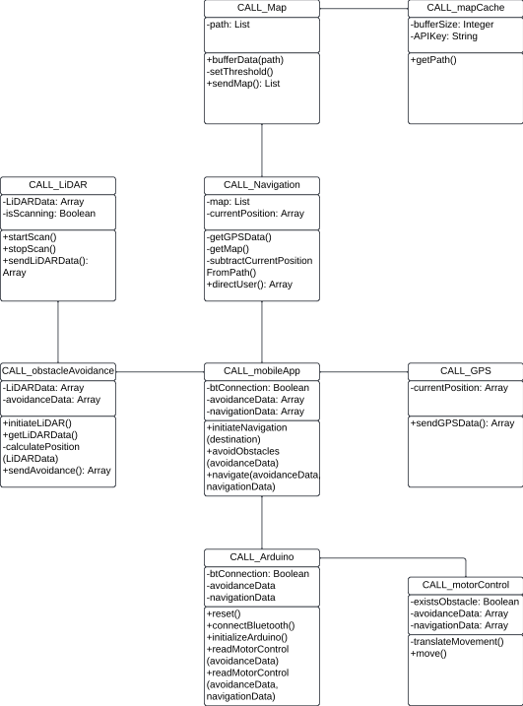
System Architecture Overview
Notes:
Include updated UML diagrams, such as a system-level class diagram or sequence diagram, to show how components interact
Highlight the specific part of the system being demonstrated

Slide 6
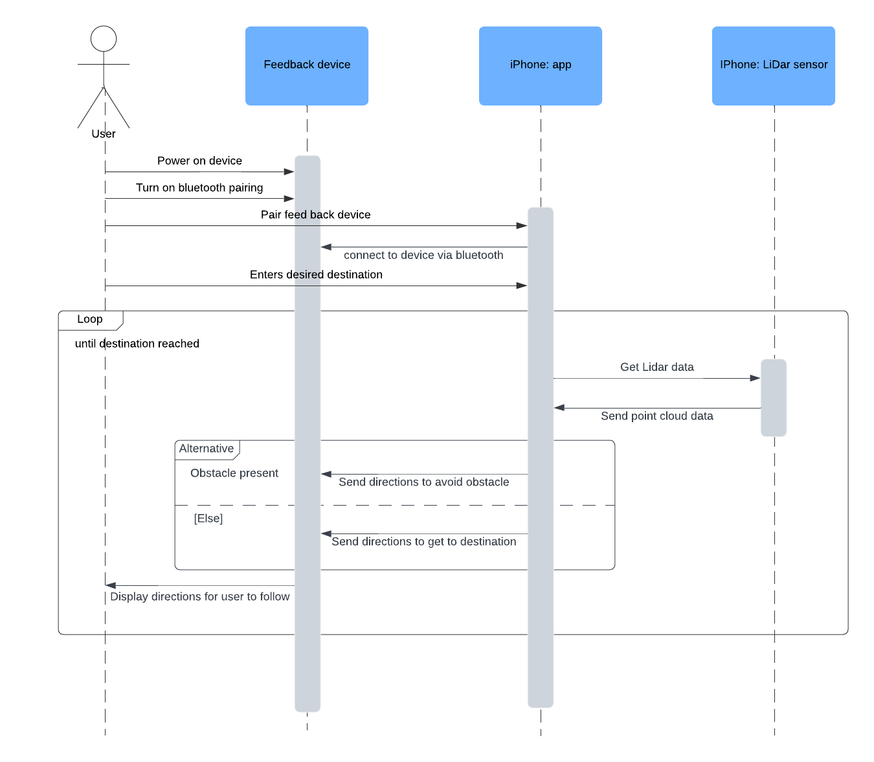
System Architecture Overview
Notes:
Include updated UML diagrams, such as a system-level class diagram or sequence diagram, to show how components interact
Highlight the specific part of the system being demonstrated

Slide 7
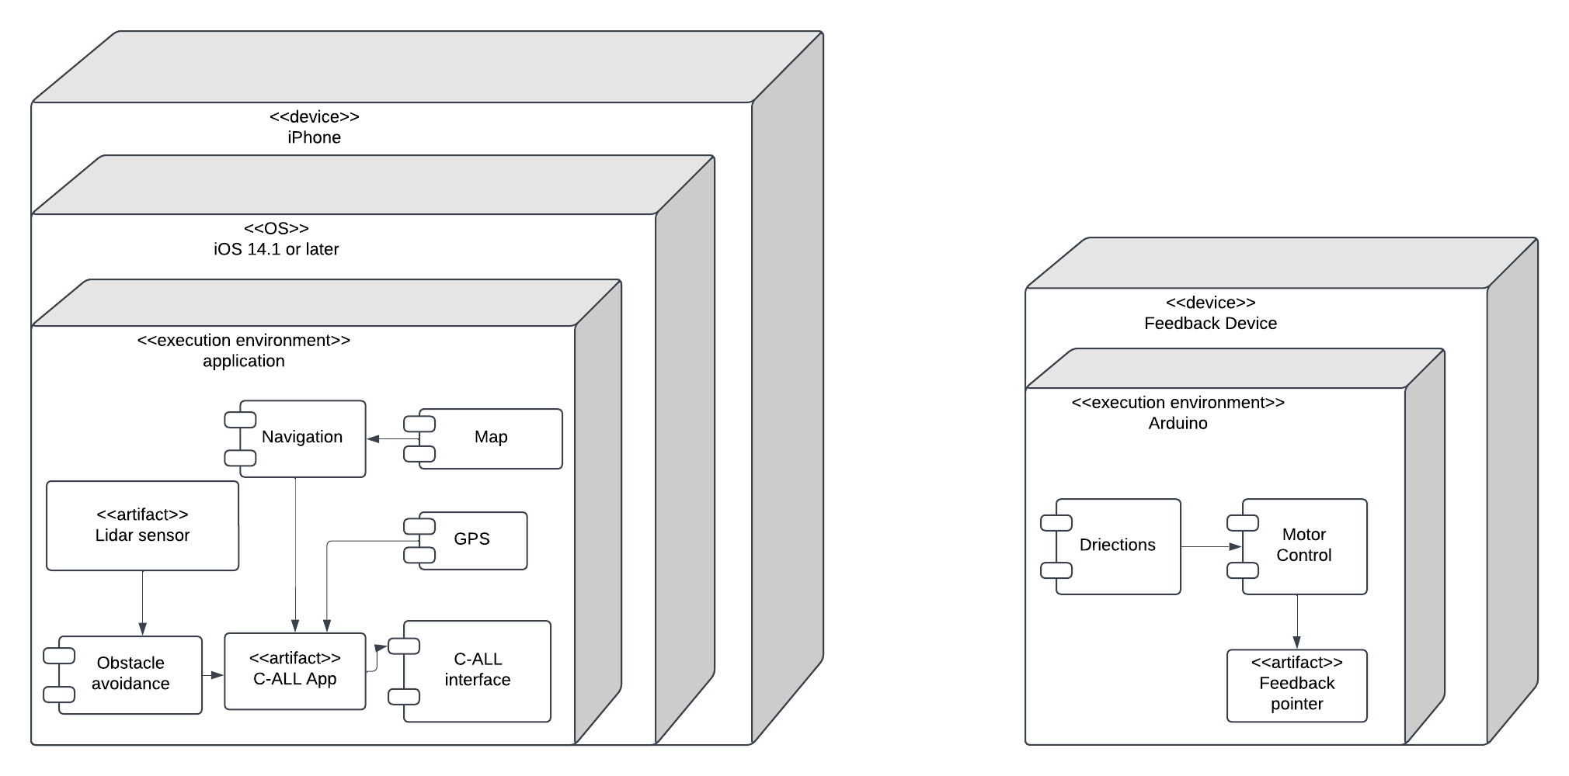
System Architecture Overview
Notes:
Include updated UML diagrams, such as a system-level class diagram or sequence diagram, to show how components interact
Highlight the specific part of the system being demonstrated

Slide 8
Prototype Demo Focus
Working Features of Software

Slide 9

Prototype Demo Focus
Notes:
A clear explanation of what is being demoed (e.g., a working feature of the software, initial hardware setup, or a component of the dev-ops pipeline)
Showcase any working aspects, such as:
LiDAR obstacle detection
Haptic feedback through the wearable device
Mobile application interface or real-time data processing.
Use visuals, animations, or live demonstrations to illustrate functionality

Slide 10
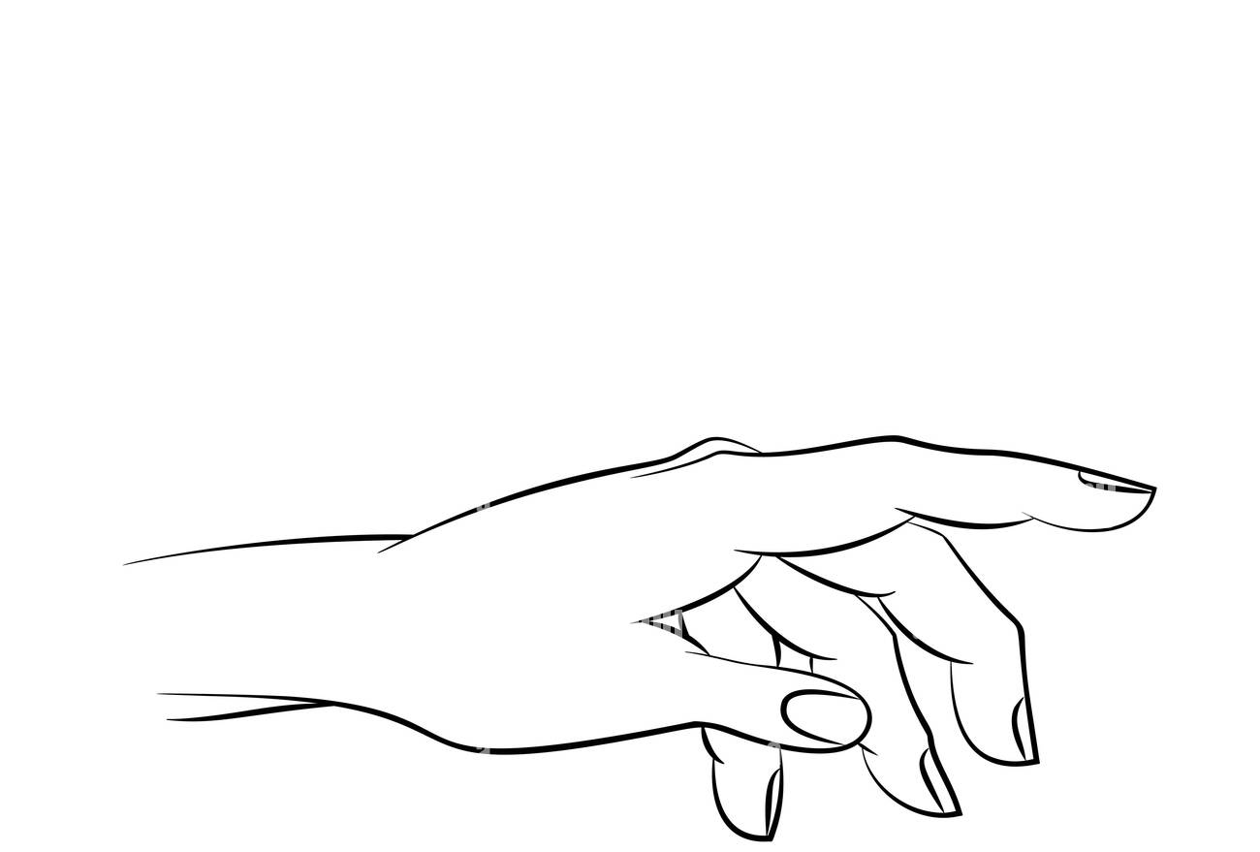
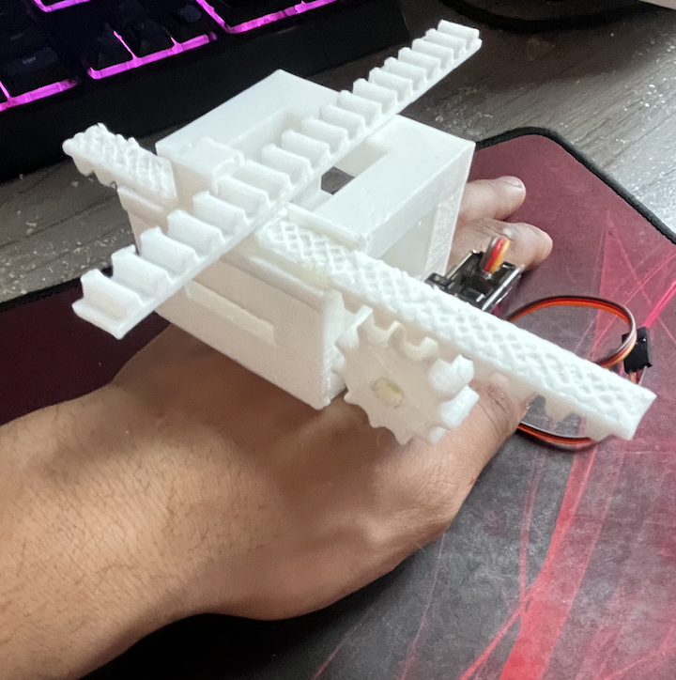
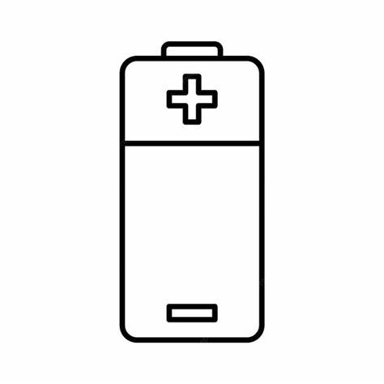
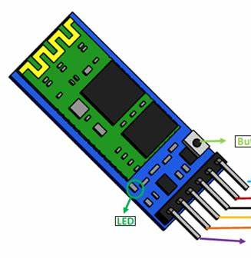
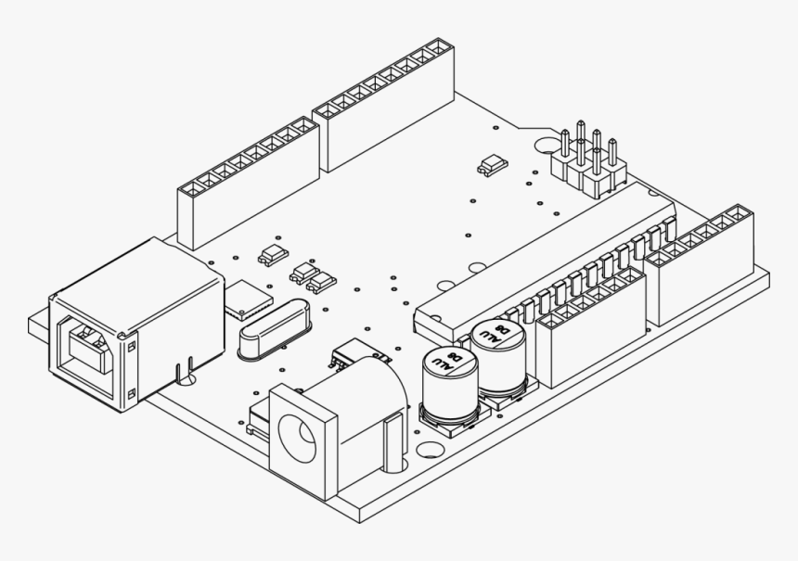
Hardware Update
The building of the glove component will commence once budget is approved and materials are received
Prior to start of spring semester, a newer version of the housing for the hardware will be designed in Solidworks and 3D printed in preparation
The housing hosting all of the motors and modules will be sewn onto the backside of a glove and ideally leaves a user’s palm and fingers free

Slide 11
Implementation Details
Key Technical Aspects

Slide 12
Implementation Details
LiDAR Processing Information
ARKit is used to collect depth information using LIDAR and constructs structured depth map
Floors are considered heavily in segmentation, by clarifying restraint
Floor meshes are identified to be navigable spaces, and any objects that are reasonably large are flagged and anchored to the mesh scene
The path is generated in the AR view updating dynamically to avoid obstacles
Communication Between Hardware and Software
Mobile application will send instructions to the hardware via Bluetooth, prompting motors to move according to navigation and/or obstacle avoidance computations
Motors are controlled by Arduino board and will receive instructions as a vector
Integration Between Hardware and Software
Ensuring strong Bluetooth connectivity with low latency – ideally using Bluetooth 5.0
Quick processing in the mobile application and the Arduino board
Notes:
Briefly explain key technical aspects, such as:
How LiDAR data is processed
Communication between the mobile app and the feedback device
Integration steps between hardware and software

Slide 13
Challenges and Solutions
Challenges Faced During Preliminary Implementation

Slide 14
Challenges and Solutions
Combining navigation with pathfinding due to difficulties in getting geo-coordinates into relative positions for AR view
Solution: Research existing applications and code to determine integration
Solution: Continue testing and refining code until results are as expected
Determining risk and potential bugs in integration between hardware and software
Solution: Begin testing integration with available parts or mock integration to understand how software works in real time
Understanding if this solution will be a viable option for the visually impaired
Solution: Conduct another round of interviews and gain detailed requirements from potential clients and other stakeholders
Notes:
Outline any challenges faced during preliminary implementation (e.g., hardware integration, user testing limitations)
Describe how the team overcame these issues or plans to address them

Slide 15
Next Steps
What the Team Plans to Focus on Next

Slide 16
Next Steps
Refining the Prototype
Improve the accuracy and performance of key features
Integration between hardware and software for seamless communication
Expanding Features
Implement additional functionality, such as improved user interface elements in mobile app
Optimize system setup processes, including calibration and device pairing
Conducting Usability Testing
Collaborate with visually impaired users to test the system in real-world scenarios
Gather insights on the user experience, accessibility, and effectiveness of navigation assistance
Use the feedback to refine both hardware and software components
Notes:
State what the team plans to focus on next, such as:
Refining the prototype
Expanding features for the final submission
Conducting usability testing

Slide 17





Thank you!
Any Questions?

